Slide 1
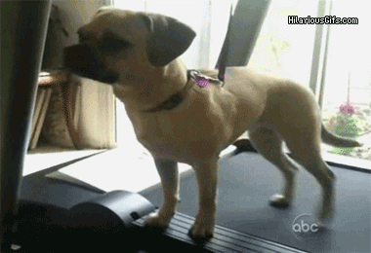
This lesson
Work done as energy transfer
Power as the rate of energy transfer
Interpreting force/distance graphs

Slide 2
Work
In physics, work has a special meaning, different to “normal” English.

Slide 3
Work
In physics, work is the amount of energy transformed (changed) when a force moves (in the direction of the force)

Slide 4
Work
For example, if Mr Porter pushes a table, he is doing work against the friction force of the table against the floor.

Slide 5
Calculating work
The amount of work done (measured in Joules) is equal to the force used (Newtons) multiplied by the distance the force has moved (metres).
Force (N)
Distance travelled (m)

Slide 6
Important
The force has to be in the direction of movement. Carrying the shopping home is not work in physics!

Slide 7
Work = Fscosθ
What if the force is at an angle to the distance moved?
F
θ
s
Fcosθ is the component of the force in the direction of movement

Slide 8
Lifting objects
When we lift objects, we are doing work because a force is moving.
Force
Distance moved

Slide 9
Lifting objects
Our lifting force is equal to the weight of the object.
Lifting force
weight

Slide 10
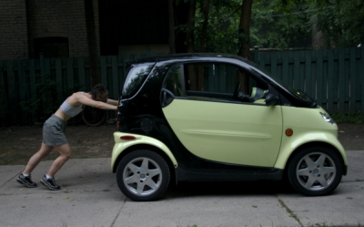
Work done (J) = Force (N) x distance (m)
A woman pushes a car with a force of 400 N at an angle of 10° to the horizontal for a distance of 15m. How much work has she done?

Slide 11
Work done (J) = Force (N) x distance (m)
A woman pushes a car with a force of 400 N at an angle of 10° to the horizontal for a distance of 15m. How much work has she done?
W = Fscosθ = 400x15x0.985
W = 5900 J

Slide 12
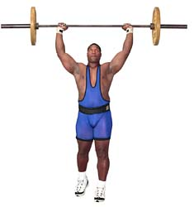
Work done (J) = Force (N) x distance (m)
A man lifts a mass of 120 kg to a height of 2.5m. How much work did he do?

Slide 13
Work done (J) = Force (N) x distance (m)
A man lifts a mass of 120 kg to a height of 2.5m. How much work did he do?
Force = weight = 1200N
Work = F x d = 1200 x 2.5
Work = 3000 J

Slide 14
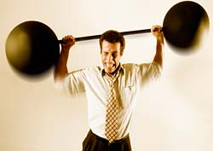
How much work can you do?

Slide 15
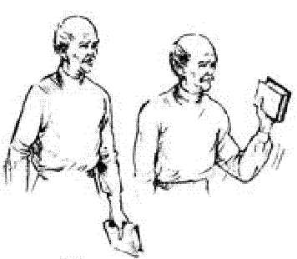
Arm curls
Force required = weight of object = mg = mass (kg) x 9.81
distance
Notes:
Explain that students are going to see how many arm curls they can do in 1 minute. They will calculate the work doen in each lift my measuring as shown on the slide.

Slide 16
Off you go!
Name | Mass (kg) | Force (N) | Distance (m) | Work of one lift (J) | # of lifts in 1 min | Total work (J)
Notes:
Students see how many arm curls they can do in a minute. Use slotted masses or dumb bells (1 kg). Students should measure the distance travelled as of course they all have different sized arms! This calculation is obviously an estimate of the work done.

Slide 17
Power!

Slide 18
Power!
Power is the amount of energy transformed (changed) per second. It is measured in Watts (1 Watt = 1 J/s)
Power = Energy transformed (work done)
time
Formula NOT in data booklet!

Slide 19
Power
For each of the people in your table, can you calculate their power?

Slide 20
Power = Fv
If a force is moving with a constant velocity, how much work is it doing?
Power = work/time = force x distance/time
Power = force x velocity = Fv

Slide 21
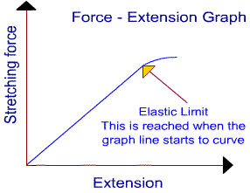
Work done in stretching a spring?

Slide 22
Work done in stretching a spring
Work done in stretching spring = area under graph
F/N
x/m

Slide 23
2.3 Hooke’s law

Slide 24
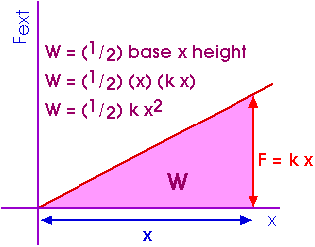
Work done in strectching a spring
E_{p} = ½kΔx²

Slide 25
This lesson
Kinetic energy
Gravitational kinetic energy

Slide 26
Work done (J) = Force (N) x distance (m)
A man lifts a mass of 120 kg to a height of 2.5m. How much work did he do?
Force = weight = mg
Distance = change in height = Δh
Work = Force x distance
Work = mgΔh

Slide 27
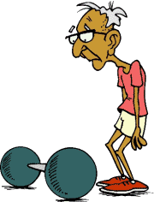
The work done is transformed in gravitational potential energy
ΔE_{p} = mgΔh
m
kg
Joules
N/kg or m/s²
Assuming constant g

Slide 28
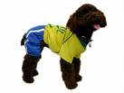
Example
Woof! (help!)
A dog of mass 12 kg “accidently” falls from an aeroplane at a height of 3.4 km. How much gravitational energy does the dog lose between falling from the plane to the ground?

Slide 29
Example
On earth g = 9.81 m.s⁻²
Mass of dog = 12 kg
Height = 3.4 km = 3400 m

Slide 30
Example
On earth g = 9.81 m.s⁻²
Mass of dog = 12 kg
GPE lost by dog = mgΔh = 12 x 9.81 x 3400 = 400 248 J
Height = 3.4 km = 3400 m

Slide 31
Kinetic energy

Slide 32
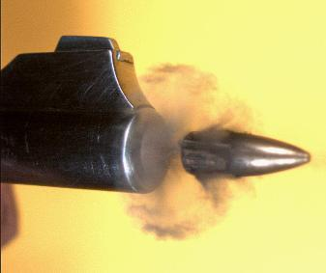
Kinetic energy
Kinetic energy of an object can be found using the following formula
E_{k} = ½mv²
where m = mass (in kg) and v = speed (in m.s⁻¹)

Slide 33
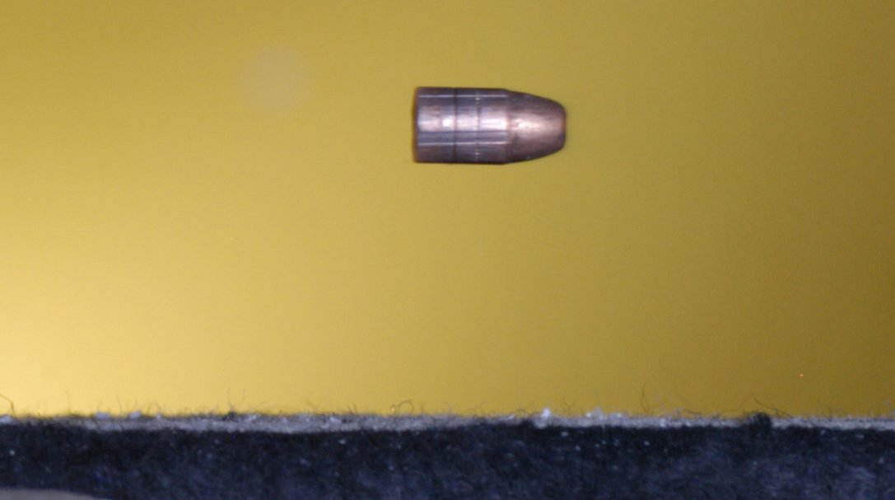
Example
A bullet of mass 150 g is travelling at 400 m.s⁻¹. How much kinetic energy does it have?

Slide 34
Example
A bullet of mass 150 g is travelling at 400 m.s⁻¹. How much kinetic energy does it have?
E_{k} = ½mv² = ½ x 0.15 x (400)² = 12 000 J

Slide 35
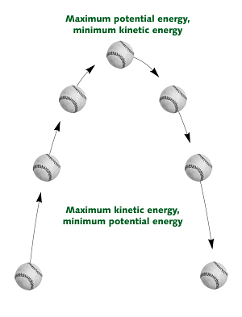
Energy changes

Slide 36
Example
GPE lost by dog = mgh = 12 x 10 x 3400 = 400 248 J
Just before the dog hits the ground, how fast is the dog travelling? (assuming no air resistance)

Slide 37
Example
GPE lost by dog = kinetic energy gained
400 248 J = ½mv²
400 248 = ½ x 12 x v² = 6v²
66708 = v²
V = (66708)^{½} = 258 m.s⁻¹
Why will the dog actually being going slower than this? What has the GPE changing into instead?

Slide 38
2.3 GPE and KE questions

